Slide 1
Where to open a restaurant or cocktail bar …
…in the Greater Toronto Area?

Slide 2
Background information
A demographic change is ocurring in the Greater Toronto Area. Due to the increasing cost of living in Toronto, many people have been moving to nearby cities.
Additionally, the expansion of the GO system has faciliated this migration with better connectivity to Toronto.
New business opportunities will arise with the population growth in these neighboring cities, so as to cater to the new inhabitants.
This report is targeted at inverstors who are looking to start a new business while benefiting from the current demographics change in the cities of Mississauga, Burlington, Oakville, Hamilton and Kitchener.
The insights generated from this report will help support and optimize investment decisions on where to open a restaurant or a cocktail bar is those cities.

Slide 3
Data
The data points utilized in this analysis were:
number of existing restaurants in Mississauga, Oakville, Burlington, Hamilton and Kitchener
their respective geolocations
distance from each other
Furthermore, Foursquare API data has been used for:
coordinates of current restaurants and cocktail bars
number of existing restaurants
coordinates of the selected Greater Toronto Area cities

Slide 4
Methodology
The key criteria utilized to select the best locations to open a restaurant or cocktail bar were:
competition in level in each of the cities represented by the number of restautants/cocktail bars in each.
density of restaurants in those cities by calculating their MDMC (mean distance form mean coordinates).
Lastly, simple statistics, such as calculating a center coordinate of the venues and the mean of the Euclidean distance from each venue to the mean coordinates.

Slide 5
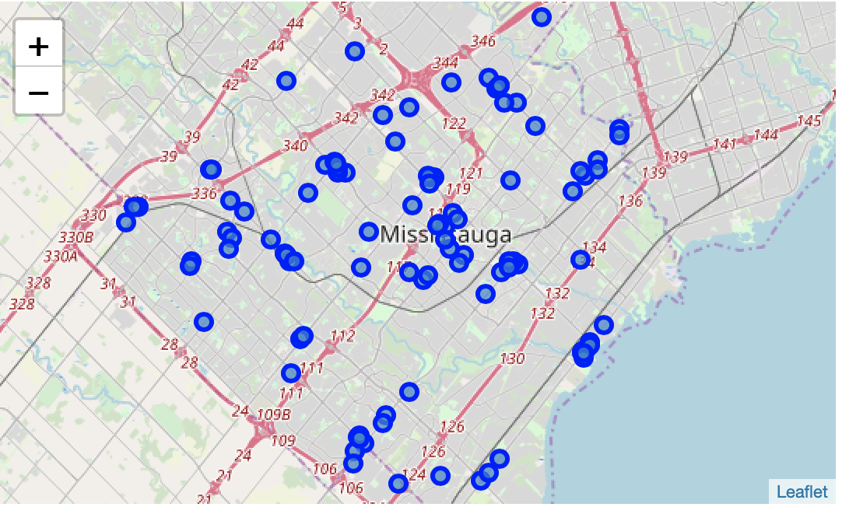
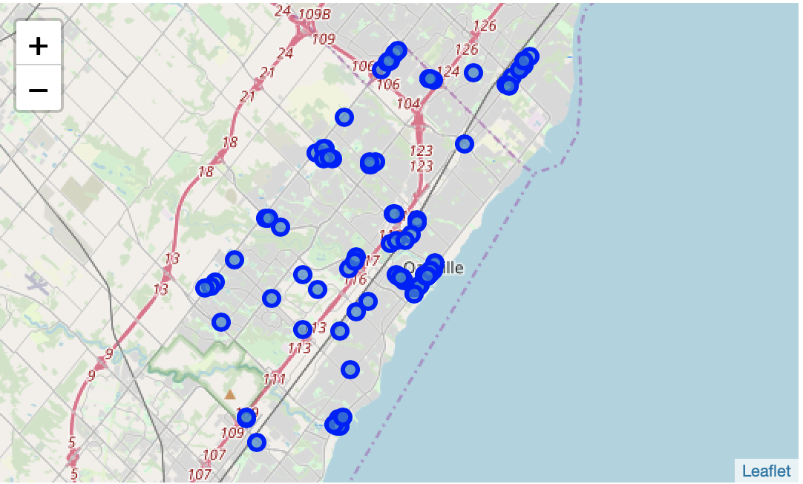
Results In the initial visualization below generated with folium, we can identify several restaurants in the 5 selected cities. Below are the pictures for each…
Mississauga
Oakville

Slide 6
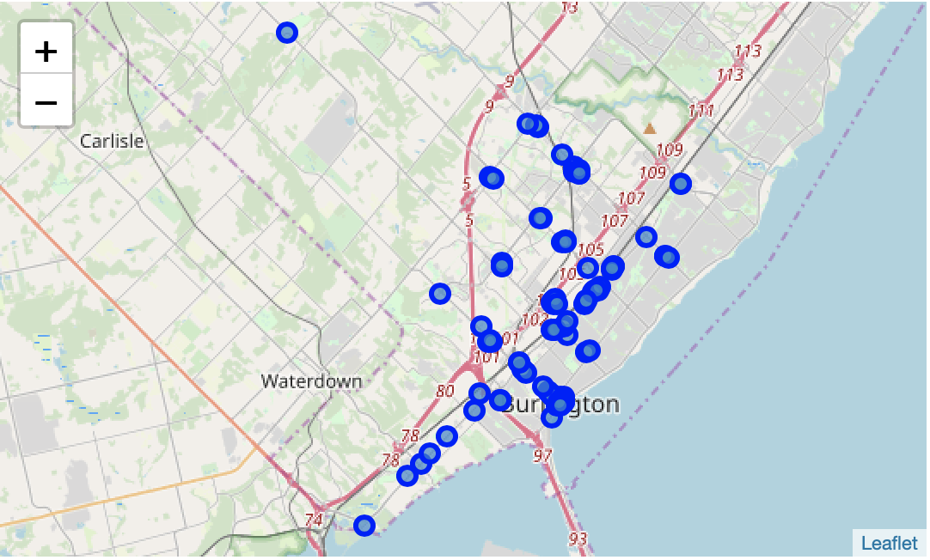
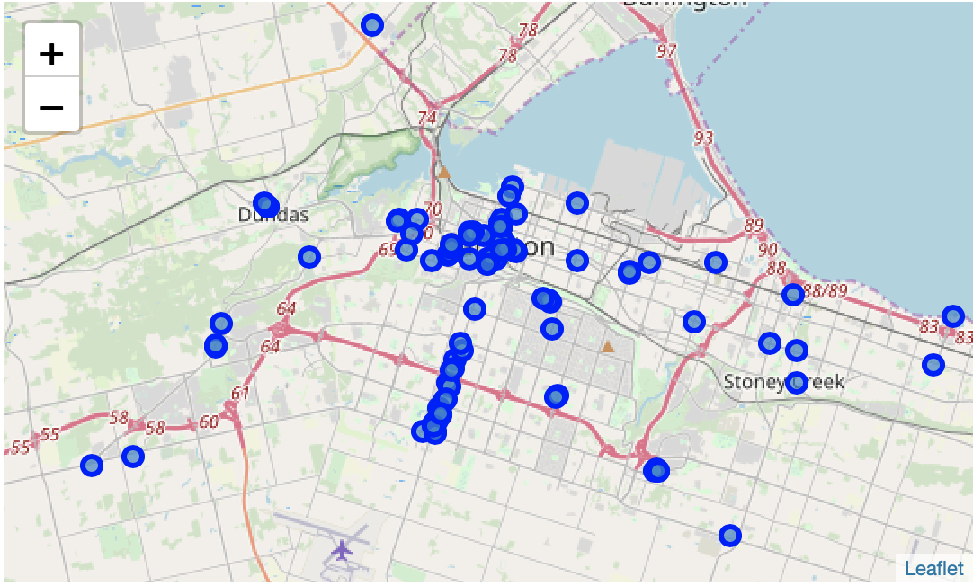
Results In the initial visualization below generated with folium, we can identify several restaurants in the 5 selected cities. Below are the pictures for each…
Burlington
Hamilton

Slide 7
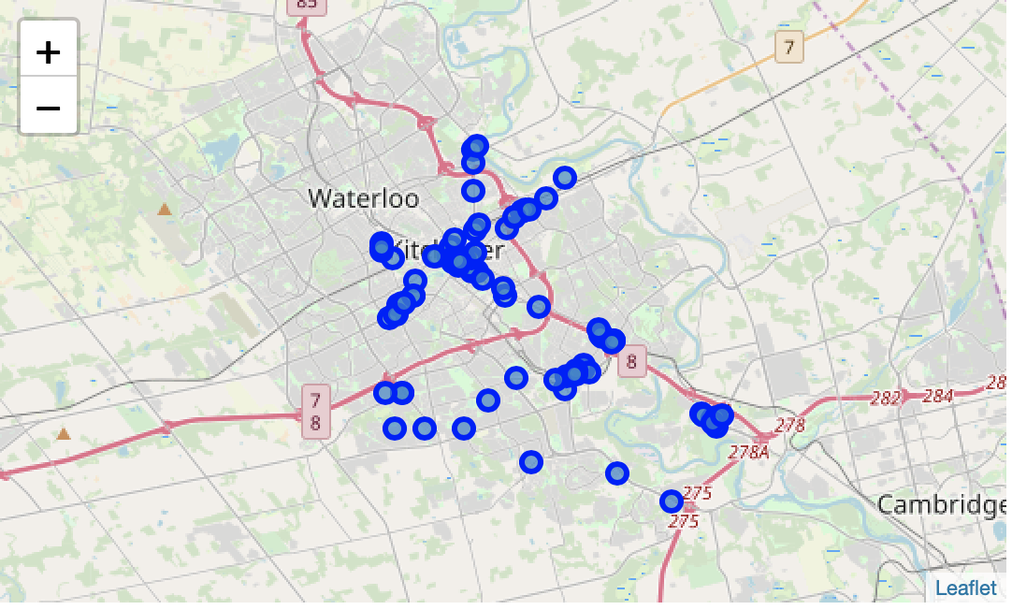
Results … The total number of restaurants has also been identified in each city.
Kitchener
Total number of RESTAURANTS in Hamilton, ON = 102
Total number of RESTAURANTS in Burlington, ON = 99
Total number of RESTAURANTS in Oakville, ON = 94
Total number of RESTAURANTS in Kitchener, ON = 97
Total number of RESTAURANTS in Mississauga, ON = 129

Slide 8
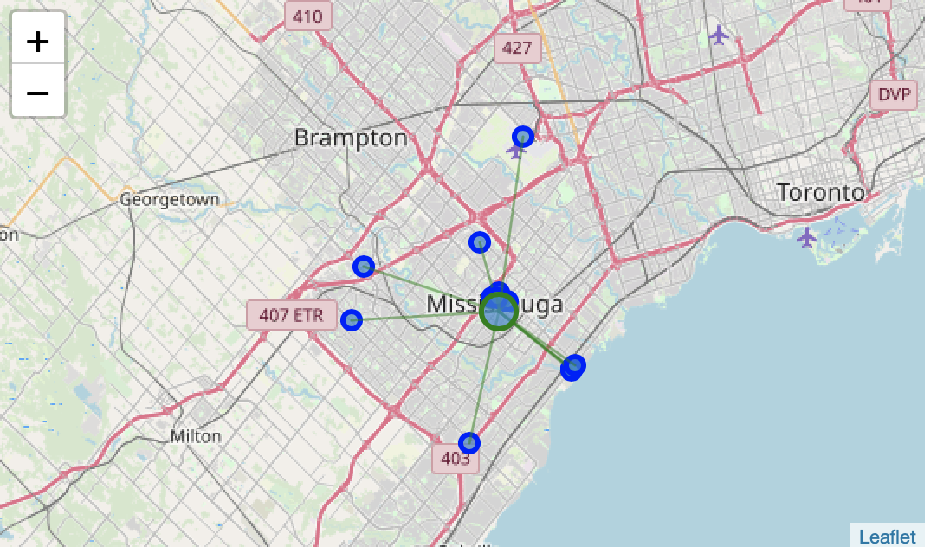
Results … now looking at the cocktail bar landscape while calculating the mean coordinates, as well as mean distance to mean coordinates. The mean coordinates are represented by the green circles and distances with green lines.
Mississauga
Total number of COCKTAIL BARS in Hamilton, ON = 4
Total number of COCKTAIL BARS in Burlington, ON = 15
Total number of COCKTAIL BARS in Oakville, ON = 8
Total number of COCKTAIL BARS in Kitchener, ON = 4
Total number of COCKTAIL BARS in Mississauga, ON = 14

Slide 9
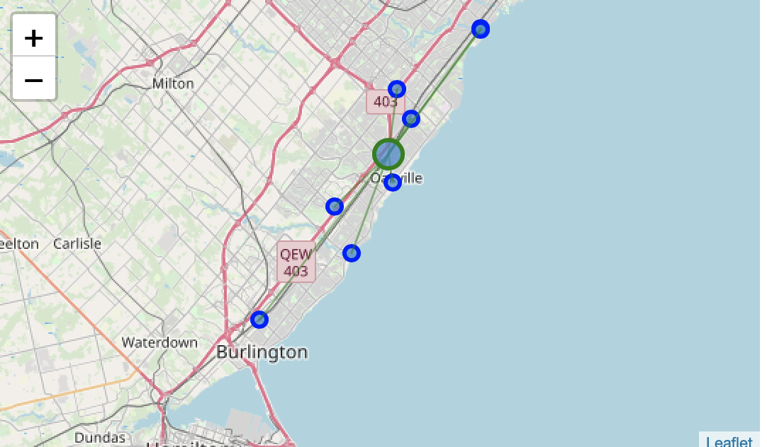
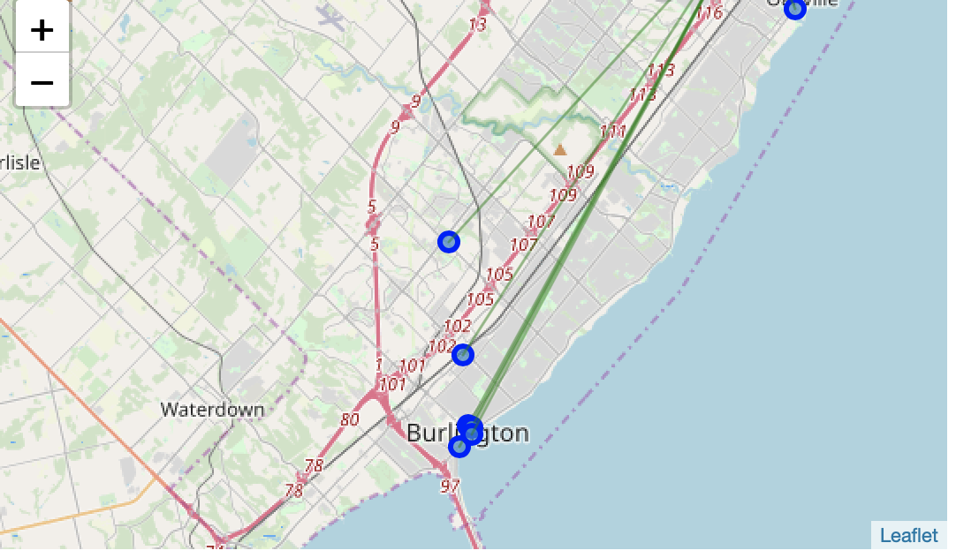
Results … now looking at the cocktail bar landscape while calculating the mean coordinates, as well as mean distance to mean coordinates. The mean coordinates are represented by the green circles and distances with green lines.
Oakville
Burlington

Slide 10
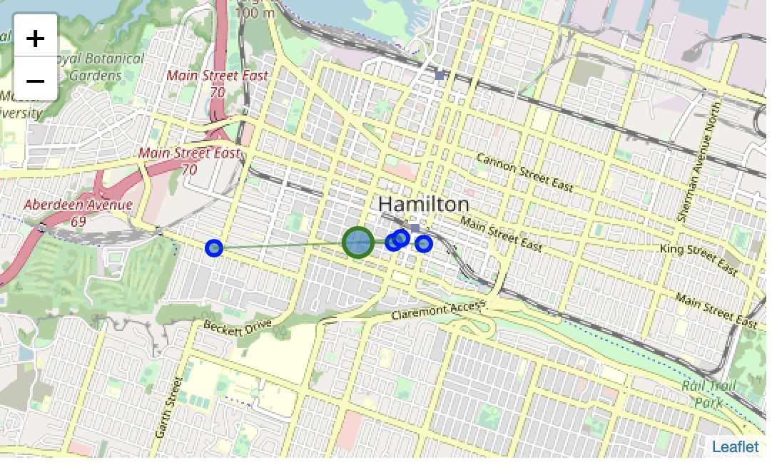
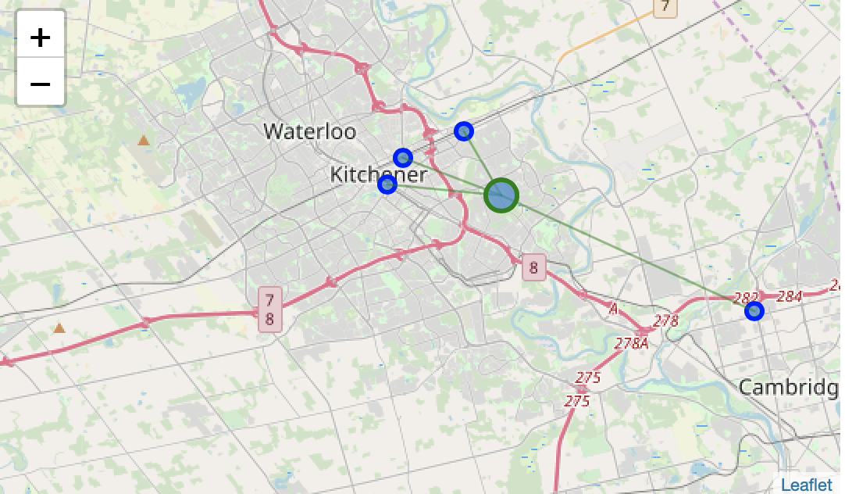
Results … now looking at the cocktail bar landscape while calculating the mean coordinates, as well as mean distance to mean coordinates. The mean coordinates are represented by the green circles and distances with green lines.
Hamilton
Kitchener

Slide 11
discussion
there’s indication that the restaurant industry is saturated in the assessed cities; however, the cocktail bars landscape looks more promising due to the lower competition.
ranking mean distanced from mean coordinates from lowest to highest (MDMC):
Hamilton = 0.008650111167283064
Mississauga = 0.0548394977917856
Kitchener = 0.059882800103556726
Oakville = 0.08318628585514992
Burlington = 0.14577741180998358
looking at density and distances alone, an investor should look into opportunities to open a cocktail bar in either Hamilton or Mississauga

Slide 12
conclusion
From an investor perspective, investing in a cocktail bar is likely to be a better alternative due to the low competition, while still being able to benefit from the GTA population growth and demographic changes.
When combining the lowest MDMC with lowest number of competitors, my final recommendation would be to open a cocktail bar in Hamilton!
Kitchener would be the 2nd recommendation due to its considerably lower number of competitors (4) compared to Mississauga (14), despite its slightly higher MDMC score.

